Slide 1
E-R Diagram

Slide 2
Entity-Relationship Model
Entity-Relationship (ER) Model is based on the notion of real-world entities and relationships among them.
While formulating real-world scenario into the database model, the ER Model creates entity set, relationship set, general attributes, and constraints.
ER Model is best used for the conceptual design of a database.
ER Model is based on:
Entities and their attributes.
Relationships among entities.

Slide 3
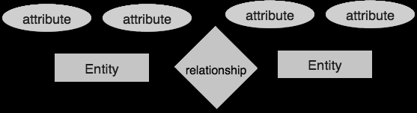

Slide 4
S_name
S_id
S_add
Student

Slide 5
Entity:-An entity in an ER Model is a real-world entity having properties called attributes. Every attribute is defined by its set of values called domain.
For example, in a school database, a student is considered as an entity. Student has various attributes like name, age, class, etc.
Relationship:-The logical association among entities is called relationship.
Relationships are mapped with entities in various ways. Mapping
cardinalities define the number of association between two entities.
Mapping cardinalities:
one to one
one to many
many to one
many to many

Slide 6
Degree of Relationship
The number of participating entities in a relationship defines the degree of the relationship.
Binary = degree 2
Ternary = degree 3
n-ary = degree
Mapping Cardinalities
Cardinality defines the number of entities in one entity set, which can be associated with the number of entities of other set via relationship set.

Slide 7
One-to-one
One entity from entity set A can be associated with at most one entity of entity set B and vice versa.
A
B

Slide 8
One-to-many
One entity from entity set A can be associated with more than one entities of entity set B, however an entity from entity set B can be associated with at most one entity.
A
B

Slide 9
Many-to-one
More than one entities from entity set A can be associated with at most one entity of entity set B, however an entity from entity set B can be associated with more than one entity from entity set A.
A
B

Slide 10
Many-to-many
One entity from A can be associated with more than one entity from B and vice versa.
A
B

Slide 11
since
Emp_id
Dep_name
Dep_id
name
Works_in
Employee
Departments
Emp_time
D_profit

Slide 12
since
Emp_id
Dep_name
Dep_id
name
Works_in
Employee
Departments
address
Location
capacity

Slide 13
Entities are represented by means of rectangles. Rectangles are named with the entity set they represent.
Attributes are the properties of entities. Attributes are represented by means of ellipses. Every ellipse represents one attribute and is directly connected to its entity (rectangle).
Relationship are represented by diamond-shaped box. Name of the relationship is written inside the diamond-box. All the entities (rectangles) participating in a relationship are connected to it by a line.
Binary Relationship is relationship where two entities are participating is called a binary relationship.
Cardinality is the number of instance of an entity from a relation that can be associated with the relation.

Slide 14
One-to-one
When only one instance of an entity is associated with the relationship, it is marked as '1:1'.
The following image reflects that only one instance of each entity should be associated with the relationship.
It depicts one-to-one relationship.
Relationship
Entity
1
1
Entity

Slide 15
One-to-many
When more than one instance of an entity is associated with a relationship, it is marked as '1:N'.
The following image reflects that only one instance of entity on the left and more than one instance of an entity on the right can be associated with the relationship.
It depicts one to- many relationship.
Relationship
Entity
1
N
Entity

Slide 16
Many-to-one
When more than one instance of entity is associated with the relationship, it is marked as 'N:1'.
The following image reflects that more than one instance of an entity on the left and only one instance of an entity on the right can be associated with the relationship.
It depicts many-to-one relationship.
Relationship
Entity
N
1
Entity

Slide 17
Many-to-many
The following image reflects that more than one instance of an entity on the left and more than one instance of an entity on the right can be associated with the relationship.
It depicts many-to-many relationship.
Relationship
Entity
N
N
Entity

Slide 18
Participation Constraints
Total Participation: Each entity is involved in the relationship. Total participation is represented by double lines.
Partial participation: Not all entities are involved in the relationship. Partial participation is represented by single lines.
Relationship
Entity
Entity
Total Participation
Partial Participation

Slide 19
Types of Attributes
Simple attribute: Simple attributes are atomic values, which cannot be divided further. For example, a student's phone number is an atomic value of 10 digits.
Composite attribute: Composite attributes are made of more than one simple attribute. For example, a student's complete name may have first_name and last_name.
Derived attribute: Derived attributes are the attributes that do not exist in the physical database, but their values are derived from other
attributes present in the database.
For example, average_salary in a department should not be saved directly in the database, instead it can be derived. For another example, age can be derived from data_of_birth.

Slide 20
Single-value attribute
Single-value attributes contain single value. For example: Social_Security_Number.
Multi-value attribute
Multi-value attributes may contain more than one values. For example, a person can have more than one phone number, email_address, etc.

Slide 21
If the attributes are composite, they are further divided in a tree like structure. Every node is then connected to its attribute. That is, composite attributes are represented by ellipses that are connected with an ellipse.
Last name
First name
S_name
S_id
S_add
Student

Slide 22
Multivalued attributes are depicted by double ellipse.
Last name
First name
S_name
S_id
S_add
Student
Phone_no

Slide 23
Derived attributes are depicted by dashed ellipse.
Last name
First name
S_name
S_id
S_add
Student
Phone_no
Age

Slide 24
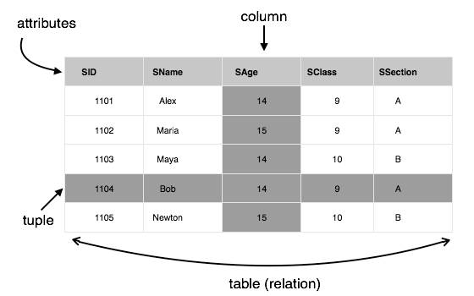
Relational Model
The most popular data model in DBMS is the Relational Model. It is more scientific a model than others. This model is based on first-order predicate logic and defines a table as an n-ary relation.]

Slide 25
The main highlights of this model are:
Data is stored in tables called relations.
Relations can be normalized.
In normalized relations, values saved are atomic values.
Each row in a relation contains a unique value.
Each column in a relation contains values from a same domain.

Slide 26
Database schema
A database schema is the skeleton structure that represents the logical view of the entire database.
It defines how the data is organized and how the relations among them are associated.
It formulates all the constraints that are to be applied on the data.
A database schema defines its entities and the relationship among them.
It contains a descriptive detail of the database, which can be depicted by means of schema diagrams.
It’s the database designers who design the schema to help programmers understand the database and make it useful.

Slide 27
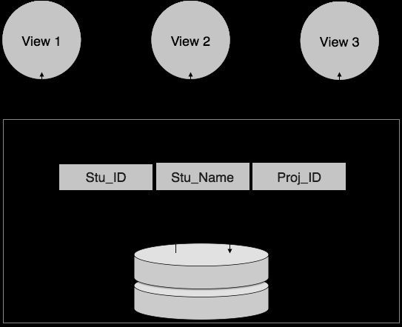
Logical schema
Physical schema

Slide 28
Database Instance
Database schema is the skeleton of database. It is designed when the database doesn't exist at all.
Once the database is operational, it is very difficult to make any changes to it. A database schema does not contain any data or information.
A database instance is a state of operational database with data at any given time.
It contains a snapshot of the database. Database instances tend to change with time.
A DBMS ensures that its every instance (state) is in a valid state, by
diligently following all the validations, constraints, and conditions that the database designers have imposed.

Slide 29
Physical Database Schema
This schema pertains to the actual storage of data and its form of storage like files, indices, etc. It defines how the data will be stored in a secondary storage.
Logical Database Schema
This schema defines all the logical constraints that need to be applied on the data stored. It defines tables, views, and integrity constraints.

